Slide 1




MICROSOFT IMAGINE CUP
2023
Team Parenthesis
Presents
SUPREME VISUALISATION

Slide 2


PARENTHESIS
ABOUT
TEAM
We all are undergraduates at Informatics Institute of Technology (Sri Lanka). We were partnered in our software development group project which is a core module at our university. We thought this project would be useful hence,we decide to work together and submit this project to Imagine Cup.
2023 PRESENTATION

Slide 3

PARENTHESIS
ABOUT US
Team member 1: Janith Bojitha Kudawithana
School: Informatics Institute of Technology
Major: BEng(Hons) Software Engineering
Grad. Year: 2025
Team member 2: Vidushraj Selvaraj
School: Informatics Institute of Technology
Major: BEng(Hons) Software Engineering
Grad. Year: 2025
Team member 3: Narmathan Tharmathasa
School: Informatics Institute of Technology
Major: BEng(Hons) Software Engineering
Grad. Year: 2025
Team member 4: Mujithaba Farahi
School: Informatics Institute of Technology
Major: BEng(Hons) Software Engineering
Grad. Year: 2025
2023 PRESENTATION

Slide 4
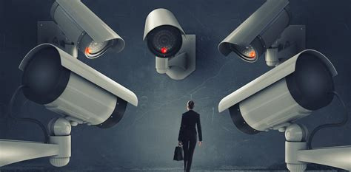
PARENTHESIS
Problem Involving
Suspious Activity Detection
Identifying suspicious people after suspicious activity happen is little bit hard. Analys cctv video footages take long time and human capacity.So How we can do?
2023 PRESENTATION

Slide 5

PARENTHESIS
Some Issues Are Occurred In
Identifying suspicious people using CCTV video footage
01
False-information
02
Analysing-error
03
Not-fully functioning algorithm
2023 PRESENTATION

Slide 6
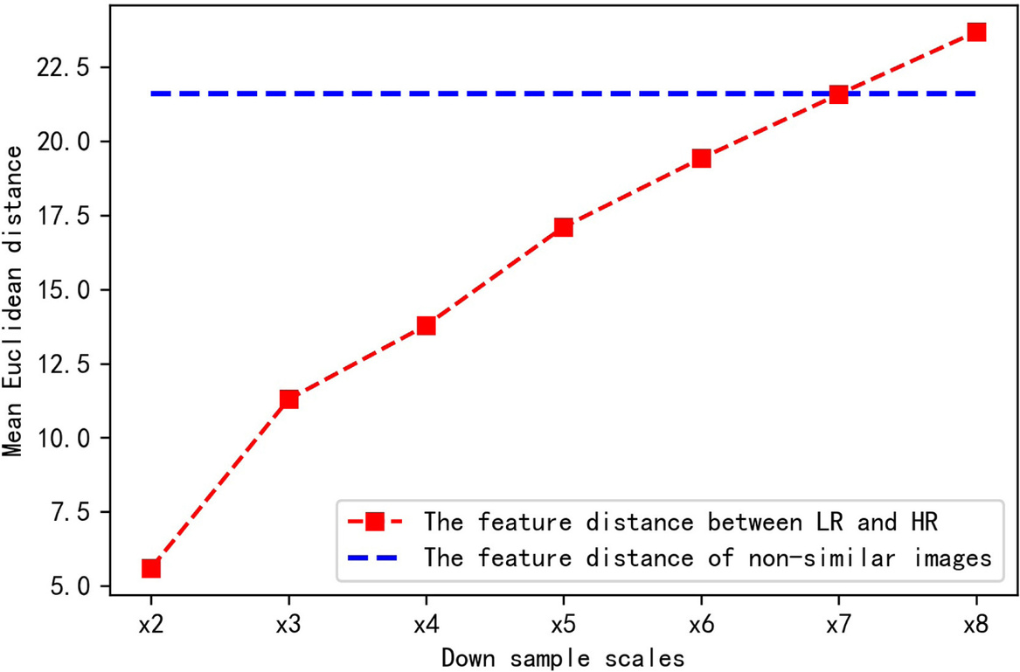
PARENTHESIS
Statical
Data
2023 PRESENTATION

Slide 7


PARENTHESIS
Our
Solution
We are developing and desktop application to analyze suspicious activities and detect suspicious people in the video footages using Linet 5
These data will send to police authorities for further investigation
Public cctv recorded video footages is benign used to this task
2023 PRESENTATION

Slide 8
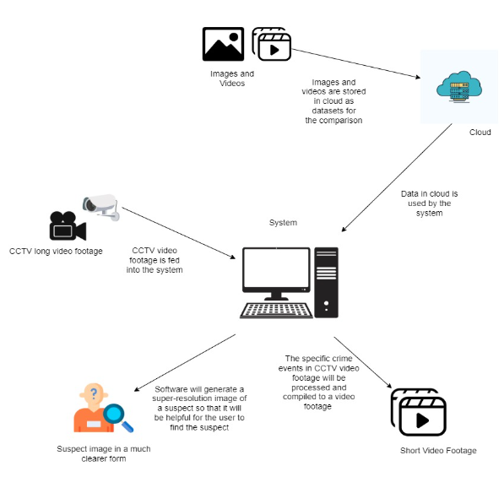
PARENTHESIS
How It
Works:
First collect video footages from the hard drives
System will analyze the footage and compare it with datasets stored in the cloud.
System will compile a video of suspicious activities occurred in the footage.
System will generate a high quality image of the suspects in the footage if user wants to generate a image of the suspect.
Compiled video and the suspect image will be displayed to the user and can be saved in a folder.
2023 PRESENTATION

Slide 9
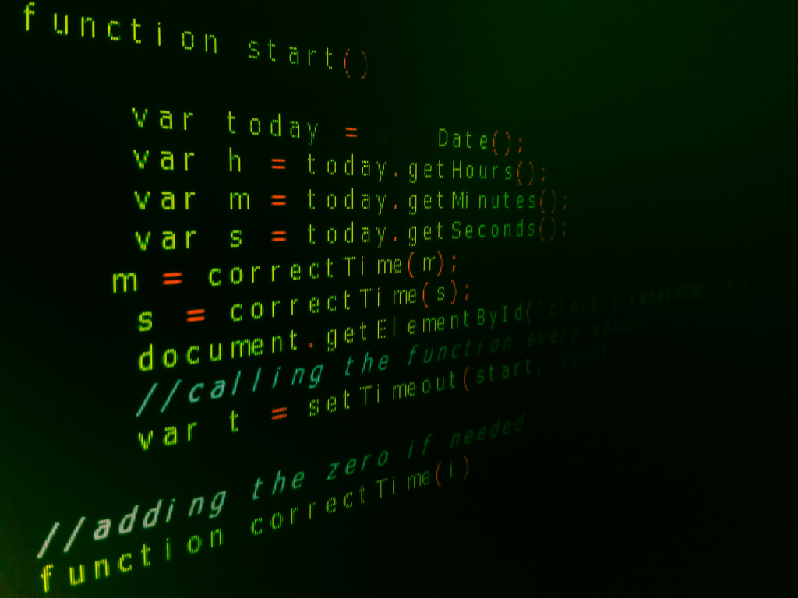

PARENTHESIS
Technical
Platforms
Desktop Application
Analyze data & detention purpose
Colubrating Software
Project Management Software
C++
HTML
Python
R
TensorFlow
Pip Python packages
Azure Cloud
PyCharm
R-Studio
Microsoft Word
Trello
GitHub
2023 PRESENTATION

Slide 10
PARENTHESIS
Scope
In-Scope
Out-Scope
Identify the occurrence of the criminal acts using footage gathered from CCTV
Create a video montages of all the desired frames
Suspected images are low-resolution,making face identification difficult.In order to deal with this problem,super resolution algorithm
A clear image is delivered to detect the person of interest.
Not design to work real-time
Not design to enhance the video
Not conclude identify actual suspect
2023 PRESENTATION

Slide 11


PARENTHESIS
The
Business Plan:
The project aims to improve the efficiency and accuracy of video surveillance systems by using advanced algorithms for detecting suspicious behavior and generating high-resolution images from CCTV footage.
The team will research and test the proposed algorithms, LeNet 5 and SRGAN, to ensure they meet the desired accuracy level of 99%.
2023 PRESENTATION

Slide 12

PARENTHESIS
Competition
01
02
The project will compete with other video surveillance systems currently available on the market that use manual methods or less advanced algorithms.
The project differentiates itself by using a combination of LeNet 5 and SRGAN algorithms, which can achieve an estimated accuracy level of 99% and improve latency.
2023 PRESENTATION

Slide 13

PARENTHESIS
Business Model
We planned to sell the developed software to companies and organizations in the public security field that use video surveillance systems.
This process may be sustainable through ongoing support and updates to the software and algorithms as needed.
We need to secure partnerships with companies or organizations in the public security field to market and distribute the product.
Additionally, we also explore other revenue streams such as licensing the technology to other companies or providing consulting services for implementation and integration of the system.
2023 PRESENTATION

Slide 14


PARENTHESIS
Business Model
We should also consider the ethical and privacy implications of their technology and ensure that it is compliant with relevant laws and regulations.
This project has a reasonable chance of success in the public security field given the growing importance of video surveillance and the limitations of current systems.
Overall, we should develop a well-defined plan for bringing the product to market, including a clear understanding of the target market, a sustainable business model, and a strategy for addressing the competition and any potential risks and challenges.
2023 PRESENTATION

Slide 15


PARENTHESIS
Business Model
To bring the product to market, the team would need to identify potential customers and partners, create a sales and marketing strategy, and build a team with the necessary expertise to execute on the business model.
The team should also consider the cost of development, maintenance, and customer support when pricing the product.
They should also consider the competition and the market demand when deciding on the pricing strategy.
The team should also plan for the potential risks and challenges that may arise during the development and implementation process and have contingency plans in place.
2023 PRESENTATION

Slide 16

PARENTHESIS
Cost
Structure
TOTAL PROJECT COST $2,128.28
Hardware Cost $1364.28
Software cost $13.64
License cost $27.29
Engineer cost $682.14
Other $40.93
No of Projects to break even 10 Projects
Subscription fee per year $13.64
2023 PRESENTATION

Slide 17

PARENTHESIS
THANK YOU
2023 PRESENTATION

